Slide 1
Investigating Influencer Endorsements:
A Data-Driven Exploration
Jinhang Jiang, Bhavana Patil, Dhruv Tyagi, Jinghuan Li
Guided by: Dr. Victor Benjamin
Notes:
https://employees.wpcarey.asu.edu/resources/marketing-and-communications/templates

Slide 2
Agenda
Business Motivation
Model Design & Implementation
Text Analysis
Social Network Analysis
Case study
Exploring Instagram
Summary
Notes:
So, for a temporary title of our presentation, it could be “Decision Support System for Adidas Endorsement “ or something similar. And the data is mainly from Reddit, including text data(comments) and user interaction data. We also explore the Instagram for image data. And the techniques we used are social network analysis, similarity analysis(based on recommender system), and text analytics(word2vec). We can the output from our DSS is matching up Adidas internal human analysis, it would be a good help. And we also did a case study assuming if they want to expand market in Korea. For the additions, I wrote many scripts from collecting data to modeling, they can develop a more mature DSS based on the codes.

Slide 3
Business Motivation
Influencer marketing is increasingly important
Adidas pursues this strategy with great success (e.g., Kanye West)
But, so far the effort is largely ad-hoc or relies on much manual effort
Current approaches fails to consider unstructured data in social media (text, networks, image, video)
Thus, a decision support system would be a great of asset

Slide 4

Where did we start ?
A social news aggregation, web content rating, and discussion website
www.reddit.com

Slide 5
Why Reddit？
Reddit has over 430 million monthly active users. An increase of 30.3% from a year earlier.
52 million daily active users access Reddit.^{[6]}
25% of US adults use Reddit.
In 2020, Reddit was ranked the 7th most popular social media app in the US.
303.4 million posts were shared on Reddit in 2020, a 52.4% year-over-year growth.
2 billion comments were shared on Reddit in 2020.
It also allows for analysis of long-form social media instead of just short messages (twitter)
Source:https://backlinko.com/reddit-users

Slide 6
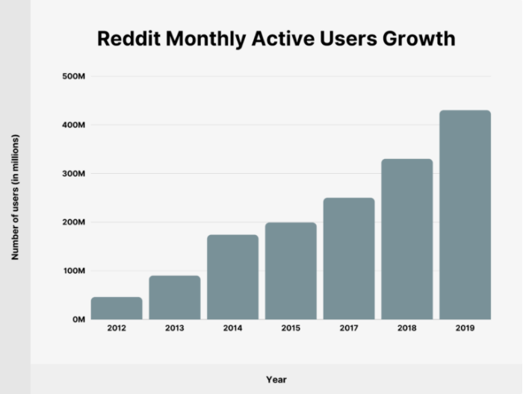
Reddit - a great source for data collection
From 2015 to 2019, the number of Reddit monthly active users has grown by 258.33%. And it continues to grow in 2020 and 2021 ...^{[6]}
Source:https://backlinko.com/reddit-users

Slide 7
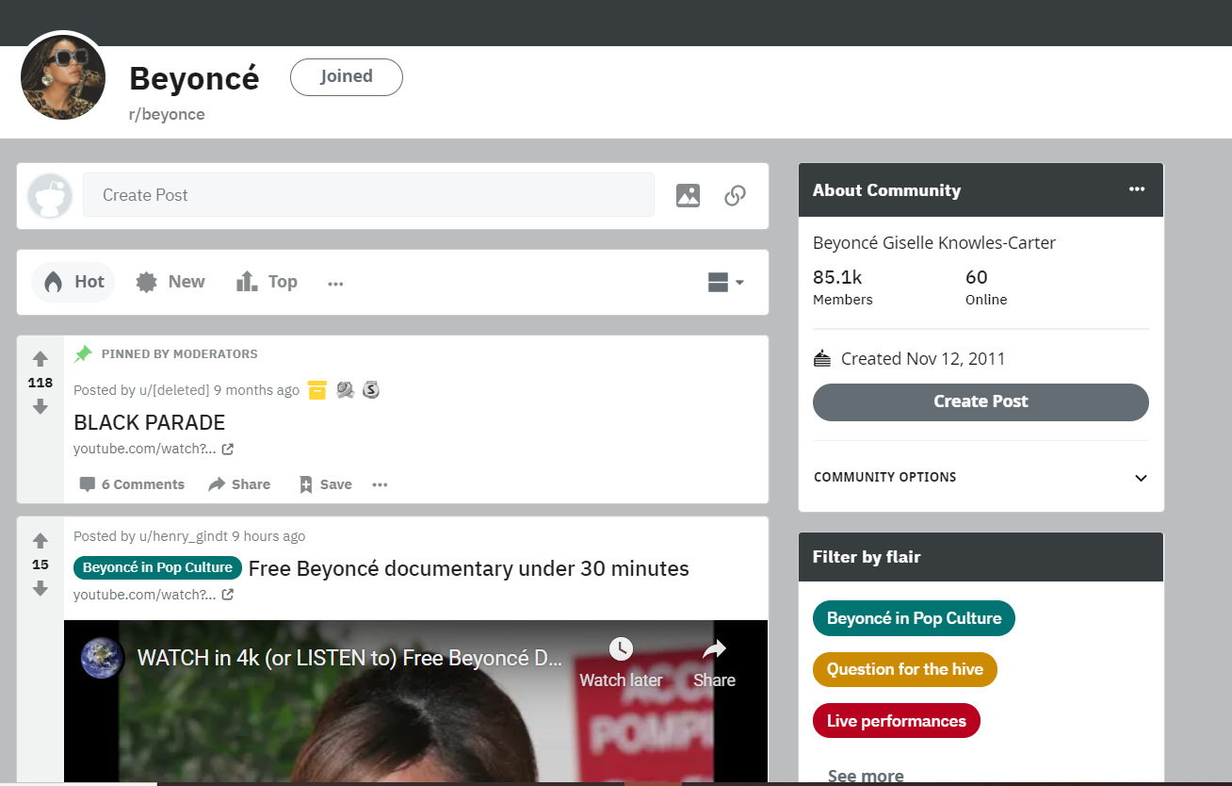
What is a subreddit?
Subreddit name
Information on the Subreddit
Information on the post

Slide 8
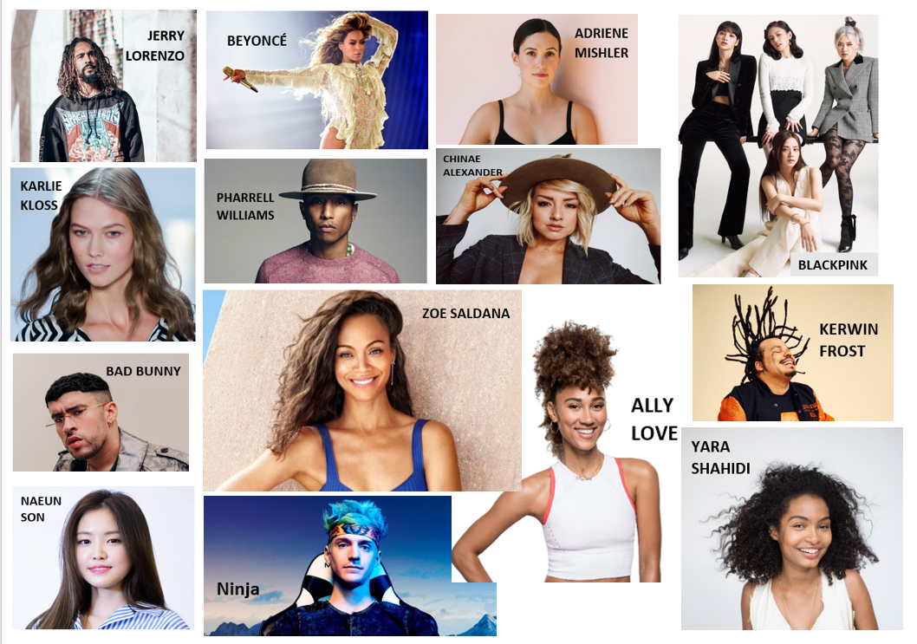
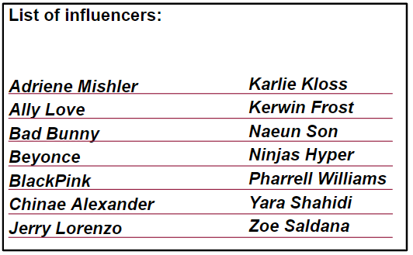
The influencers we started with:
Mr. Brooks Clemens gave us a list of influencers who are sponsored by Adidas.^{[5]} We picked 14 of them for our research.
Notes:
Given the fact that not every influencer is being mentioned regularly on Reddit,

Slide 9
About the Data
Types of data collected : user information, text data, image data^{[5]}
Total posts collected :39K+ comments, which are summed to 22M words
The number of users : 62K+ (For network analysis)
Data was collected from their respective subreddit and based on n-gram search.
Influencer | MsgID | Timestamp | Author | ThreadID | ThreadTitle | MsgBody | ReplyTo
NinjasHyper | ‘gnqnhbb’ | ‘2021-02-17’ | ‘KidCaker’ | ‘co3y25’ | ‘Stunning!...’ | ‘Epic! He…’ | ‘gnkvpte’
... | ... | ... | ... | ... | ... | ... | ...

Slide 10
Collected Data
Data is grouped into two versions for implementation testing and case study:
Version 1: 14 Celebrities is sponsored by Adidas
Version 2: Two adidas sponsored Korean celebrities + another eight picked Korean celebrities (based on stage style and popularity)

Slide 11
The design goal of the system is to:
Build a computational, data-driven, and generalizable system
Support the business decisions with
little human intervention

Slide 12
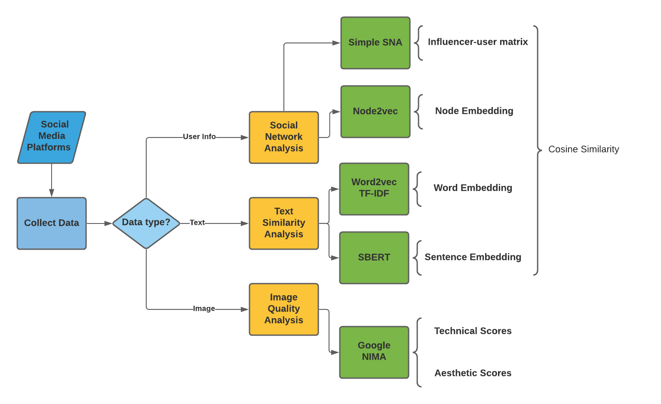
How the system works:

Slide 13
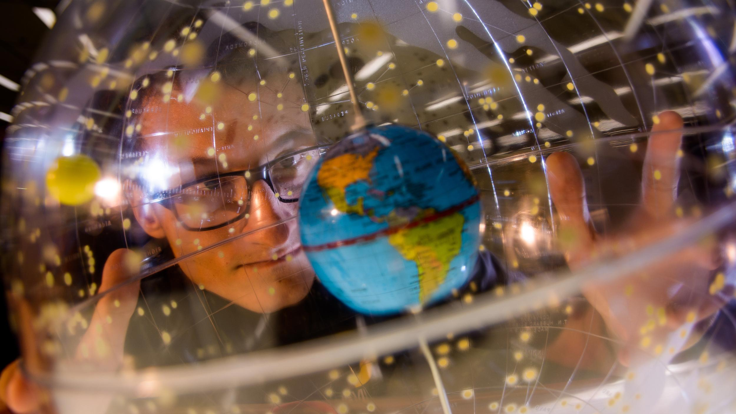
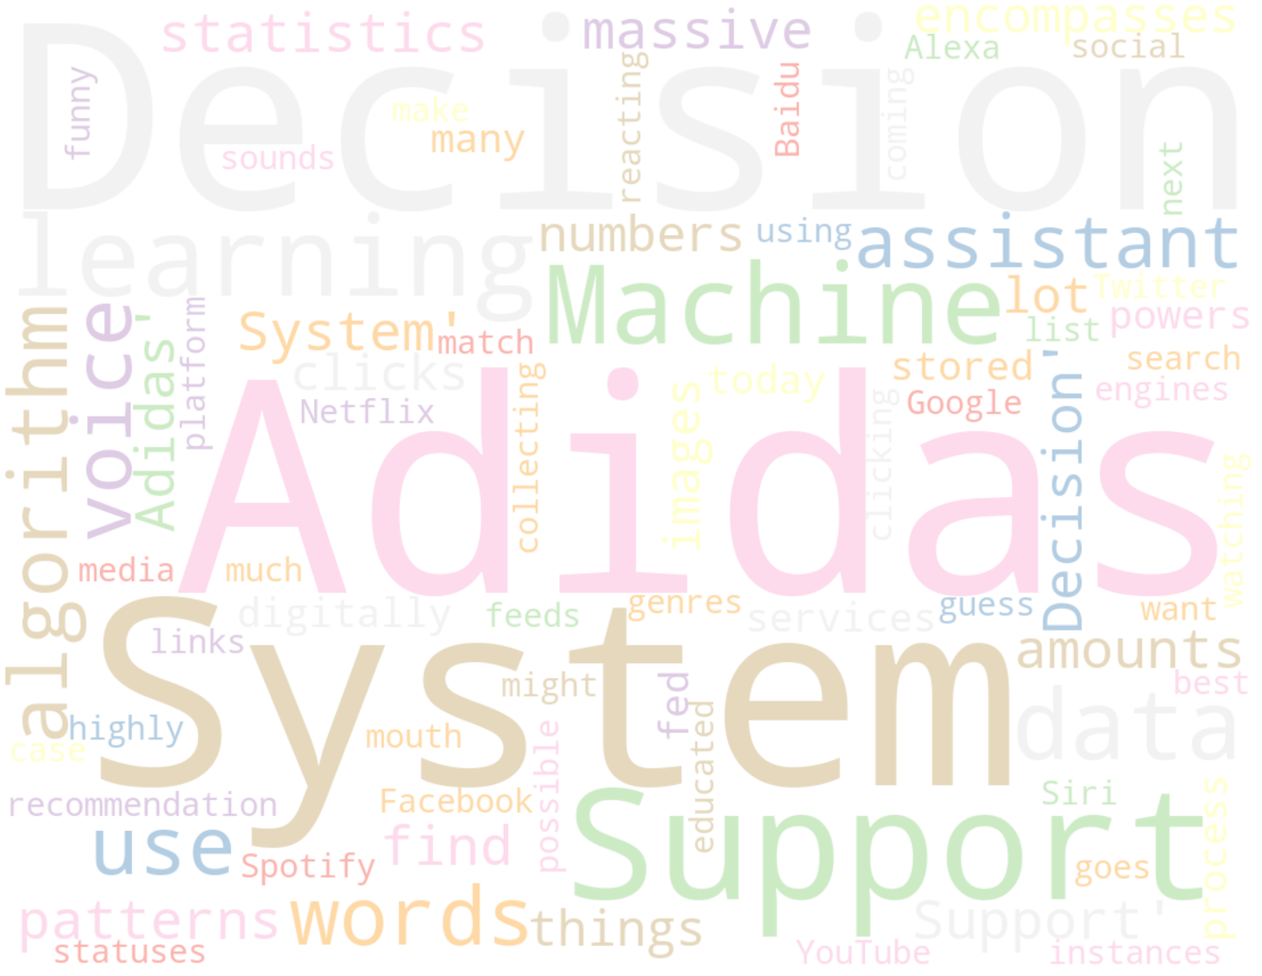
Why Text Analytics?
Text analytics is the automated process of translating large volumes of unstructured text into quantitative data to uncover insights, trends, and patterns. ^{[18]}
Combined with data visualization tools or other statistical models, this technique enables companies to understand the story behind the numbers (the transformed text) and make better decisions.^{[18]}

Slide 14
How Text Analytics benefits business analysis?
We wanted the models to look at the conversations between celebrities’ fans to capture different cultural patterns buried in the unstructured text data.
It helps our business to have a better understanding of:
how similar the way fans/users talk about the influencers
the type of customers each influencers can reach
similarity and dissimilarity of language habits between the customer segments
how the fans view the influencers

Slide 15
The List of Popular Text Mining Techniques
01
Word2vec + TF-IDF
Word embeddings
Vectors of numeric representations of words
Self-trained model
02
Sentence_Transformers
Sentence embeddings
BERT based, state of the art model
10+ pre-trained models from billions of words
03
GloVe + TF-IDF
Word embeddings
Pre-trained model
1M+ words
04
TF-IDF
Term frequency–inverse document frequency
Reflects importance of a word to a document
05
Sent2vec
Sentence embeddings
Good on small dataset (pre-trained models)
Crashed with large dataset due to RAM limits
06
Doc2vec
Document embeddings
Vectors of numeric representations of docs
Self-trained model

Slide 16
The Models in Our Decision Support System
We finally decided to include the following two models to our decision support system based on performance and computational speed.
01
Word2vec + TF-IDF^{[9]}
Word embeddings
Vectors of numeric representations of words
Self-trained model
02
Sentence_Transformers
Sentence embeddings
BERT based, state of the art model
10+ pre-trained models from billions of words

Slide 17
“Embedding” : A Task-specific Dictionary
In the context of machine learning, an embedding is a low-dimensional, learned continuous vector representation of discrete variables into which you can translate high-dimensional vectors.^{[8]}
Generally, embeddings make ML models more efficient and easier to work with, and can be used with other models as well.
For example, when applied to text, we can learn the semantic meaning of a word by observing what other words it frequently appears next to. And then we can generate a list of embeddings, which can be seen as a task-specific dictionary.

Slide 18
The Models in Our Decision Support System
01
Word2vec + TF-IDF
02
Sentence_Transformers

Slide 19
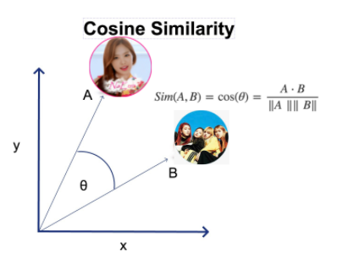
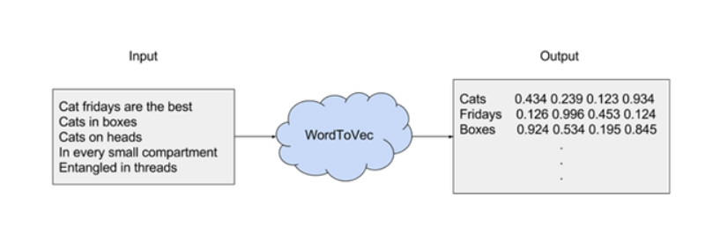
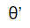

Word2vec and Cosine Similarity
Word2Vec is an algorithm that accepts text corpus as an input and outputs numerical representations for each word
Cosine similarity is a metric used to measure how similar the documents are irrespective of their size.
Word2vec
C
Source: https://jalammar.github.io/illustrated-word2vec/
Notes:
Week10 day2 - slide 39/40

Slide 20
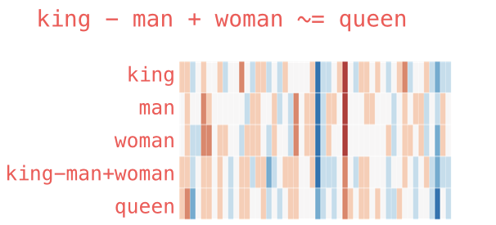
The Dictionary Captures Semantic Meaning
A famous example of the concept of analogy:
The resulting vector from "king-man+woman" doesn't exactly equal "queen", but "queen" is the closest word to it from the 400,000 word embeddings in this collection.^{[1]}

Slide 21
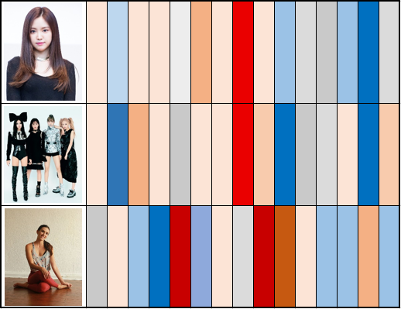
Analogy for Our Case
We can clearly perceive that the users talked about Naeun Son and BlackPink in a more similar way.
We can use this information to find :
overlaps among the users’ culture
specific groups of customers

Slide 22
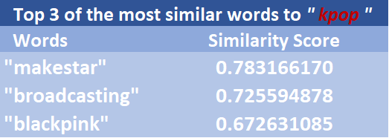
Word2vec - How to Validate the Dictionary
This is an unsupervised method, so we do not have a ground truth to evaluate if the model has captured the semantic meaning of the words
We used the most similar words of a specific word [“kpop”] as the evaluation metrics

Slide 23
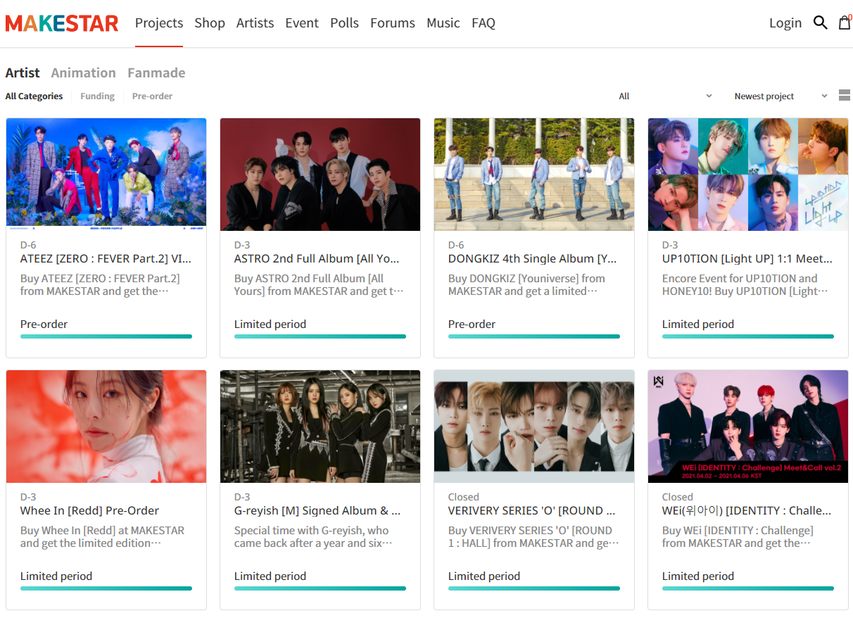
Word2vec - How to Validate the Dictionary
“Makestar”:
Makestar, which will present the projects that stars and fans make together, is a two-way communication window that helps their communication.
“Broadcasting”:
Music programs of South Korea are broadcast weekly, with different artists performing on the shows to promote their music.
more examples...

Slide 24

How to Reflect the Importance and Relevance of a Word?
TF-IDF, is a numerical statistic that is intended to reflect how important a word is to a document in a collection.
Documents with similar, relevant words will have similar vectors
It also helps discover the uniqueness of the language habits of the certain customer groups

Slide 25
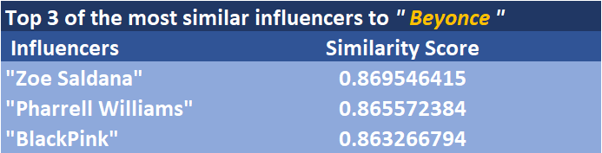
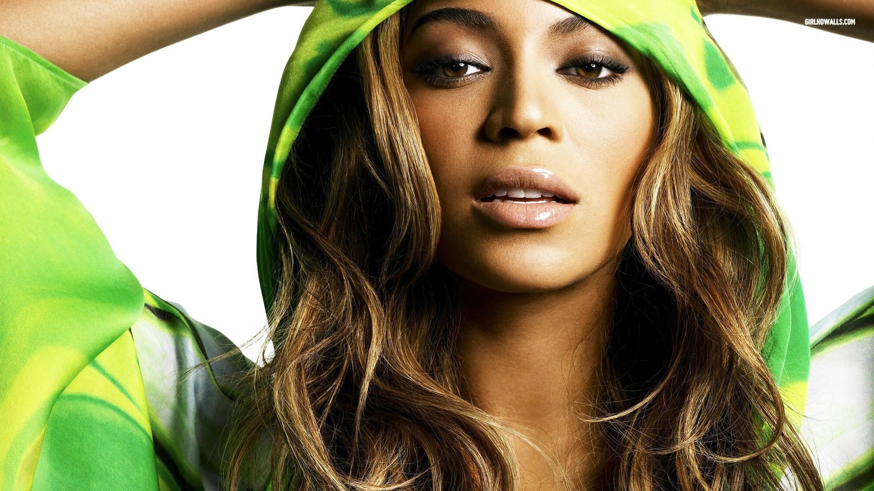
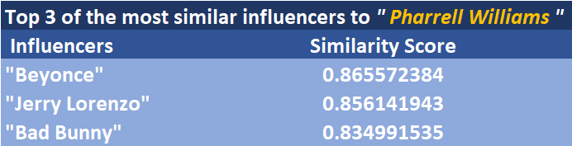
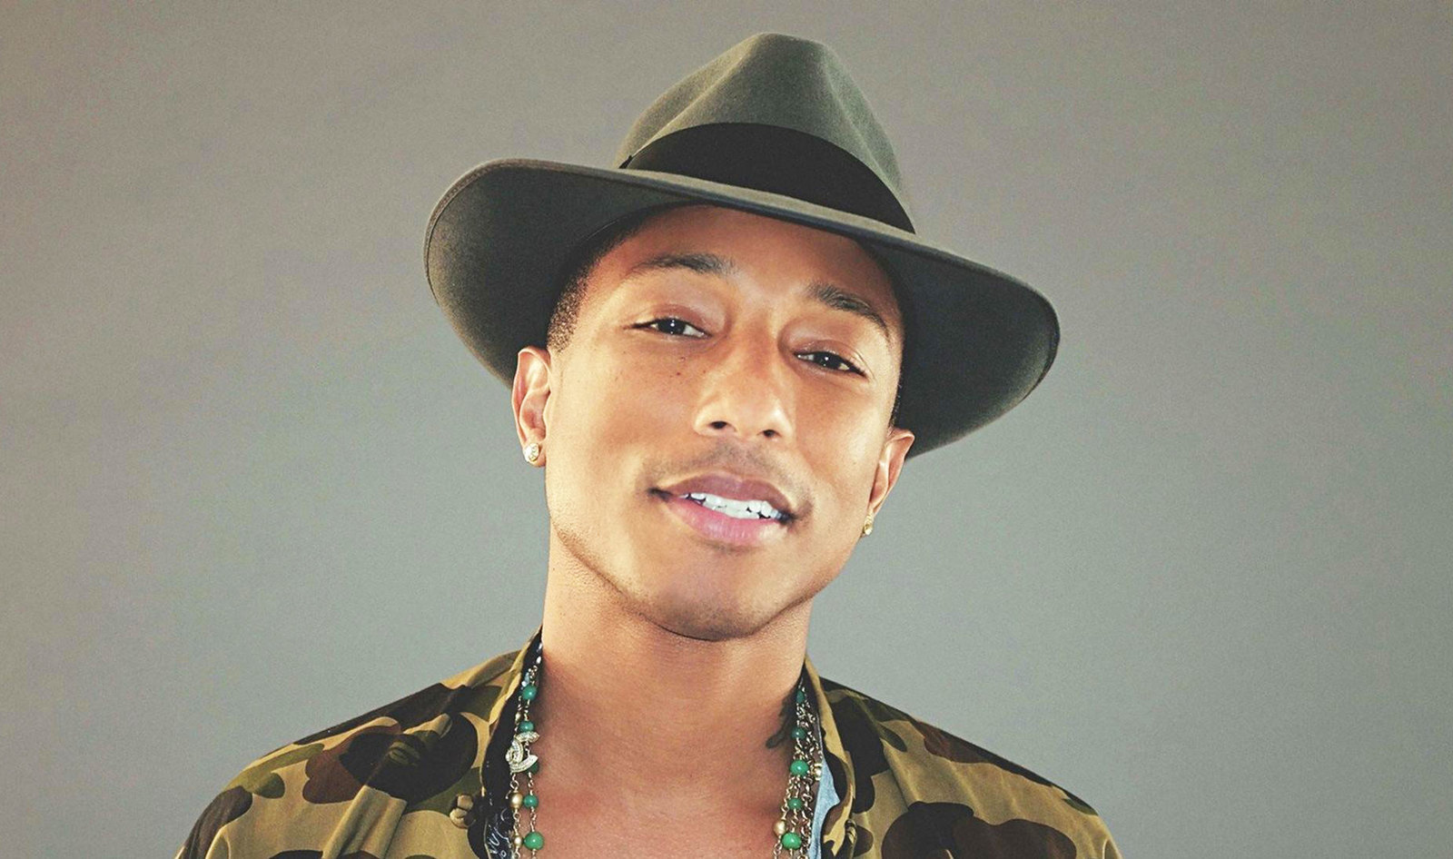
Similarity - Wording Relevance and Semantic Meaning

Slide 26
The Models in Our Decision Support System
01
Word2vec + TF-IDF
02
Sentence_Transformers
Sentence_Transformers

Slide 27
SBERT with Sentence_Transformers
BERT, machine learning technique for natural language processing pre-training developed by Google, published in 2018
Sentence BERT (or SBERT) was developed by UKP Lab from Darmstadt University of Technology in Germany
It provides an increasing number of state-of-the-art pretrained models for more than 100 languages, fine-tuned for various use-cases.

Slide 28
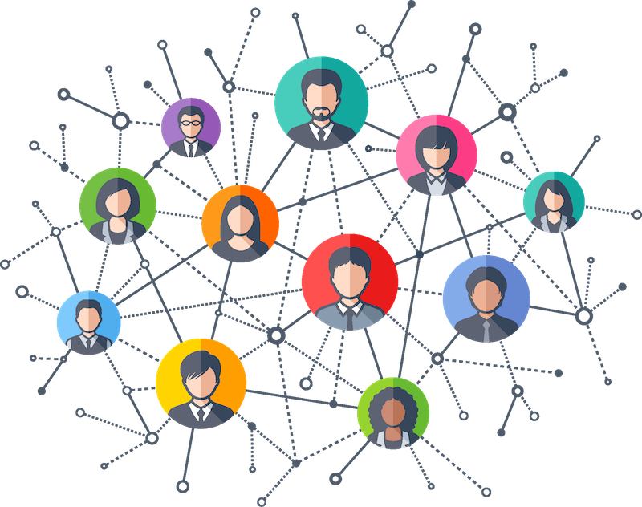
Social Network Analysis (SNA)
Social network analysis is the process of investigating social structures through the use of networks and graph theory.
It characterizes networked structures in terms of nodes and the ties, edges, or links that connect them.
Source: https://gatton.uky.edu/about-us/stay-connected/news/2020/links-center-social-network-analysis-workshop-success

Slide 29
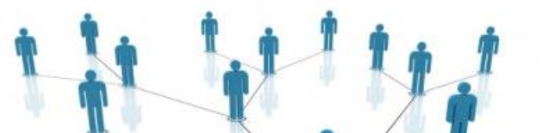
How SNA Benefits Business Analysis
In the private sector, businesses use SNA to support activities such as:
customer interaction and analysis
information system development analysis
marketing and business intelligence needs
In our case, we performed SNA to reveal information about the influencer’s fanbase activities, overlaps, and interactions

Slide 30
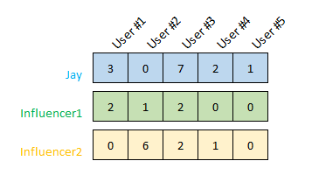
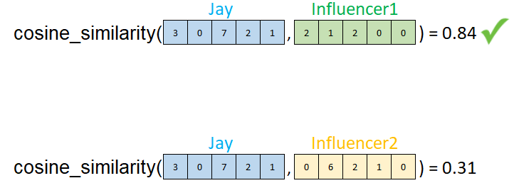
SNA with Influencer-User Matrix
We created an influencer-user (I-U) matrix to compute cosine similarity scores
Find the number of occurrences of each users for each influencer
Compute the cosine similarity between the vectors of occurrences
Sorting the results and find the closest ones

Slide 31
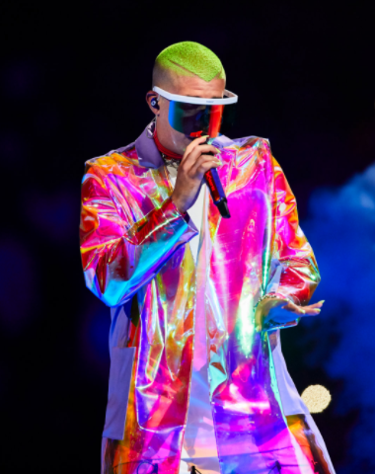
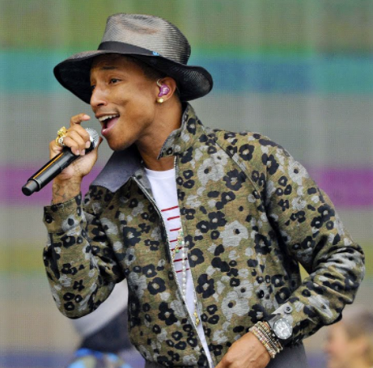
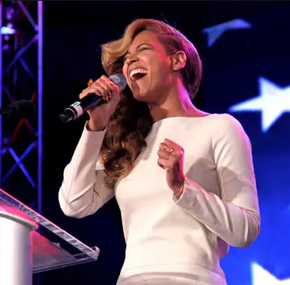
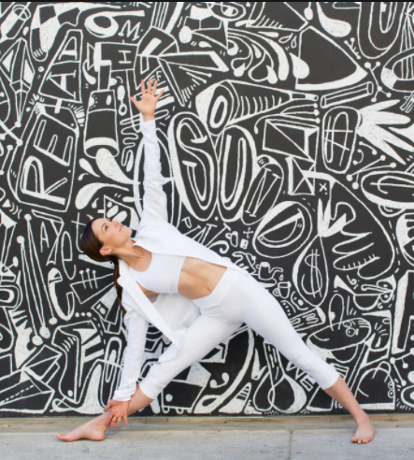
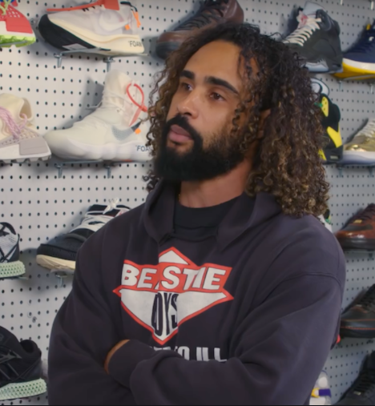

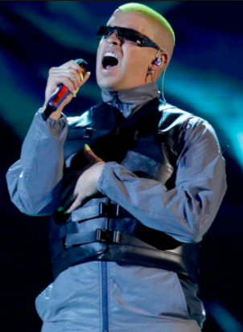

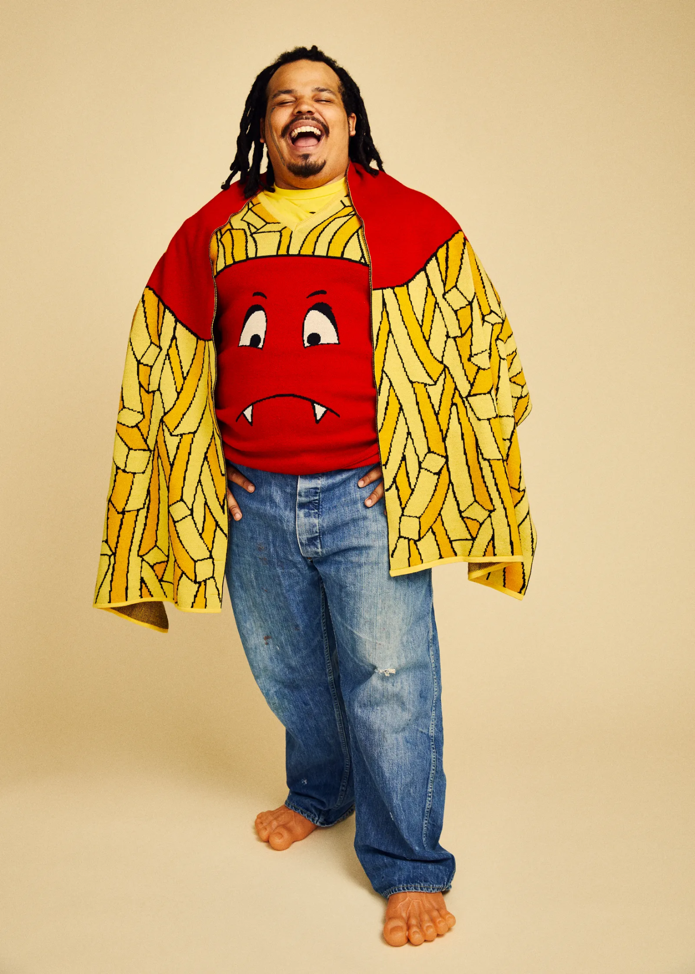
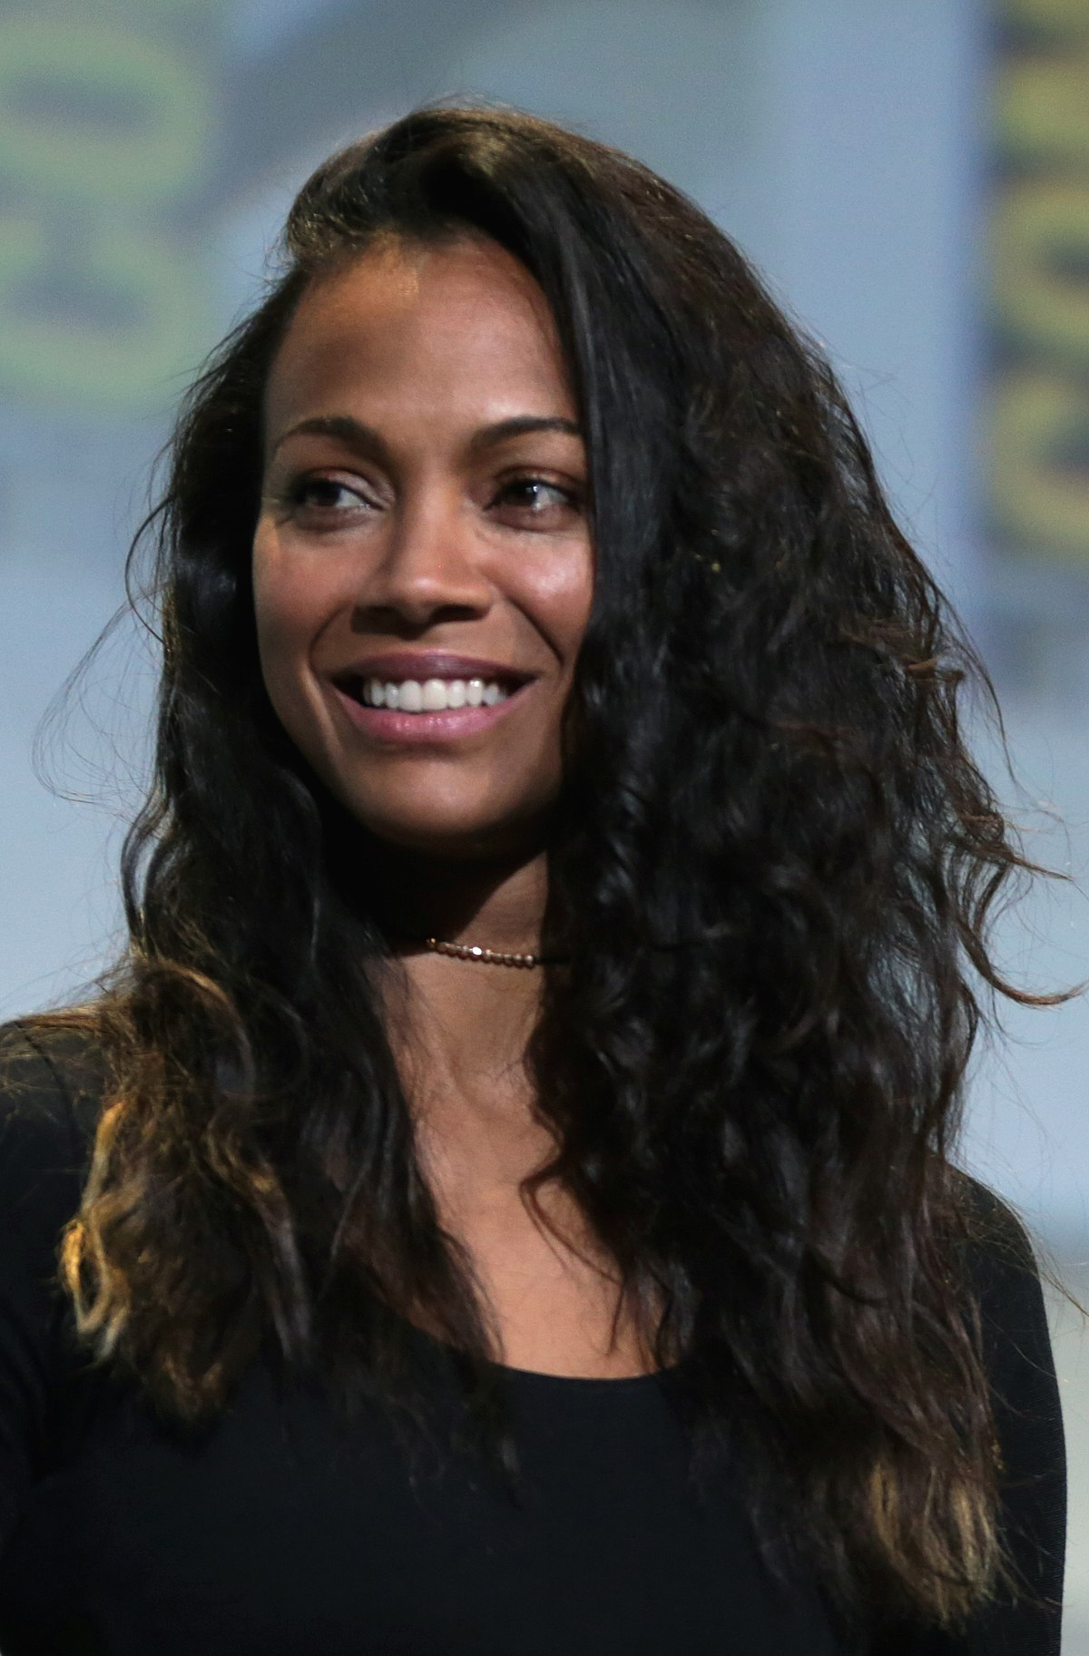
How I-U Matrix Tackles Business Questions
Beyonce
⇌
+
model.best_sub("Beyonce",n=2)
['Bad Bunny', 'Pharrell Williams’]
----------------------------------
model.best_complete("Beyonce",n=2)
['Adriene Mishler', 'Jerry Lorenzo']
⇌
+
Naeun Son
model.best_sub("Naeun Son",n=2)
['BlackPink', 'Bad Bunny']
----------------------------------
model.best_complete("Naeun Son",n=2)
['Kerwin Frost', 'Zoe Saldana']

Slide 32
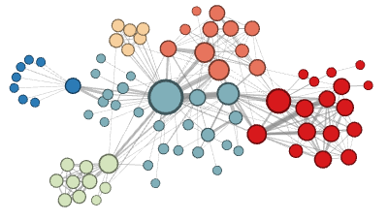
SNA with node2vec
Developed by Stanford
Built upon the idea of word2vec
Convert high dimensional data/information into a low-dimensional representations^{[2]}
By studying the relationship between the nodes, business can generate the insights of the people to whom the influencers reached
A node embeddings (or influencer’s fanbase dictionary) will be generated:
Can be used for various analysis, like K-means clustering

Slide 33
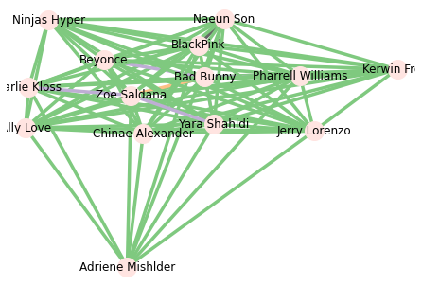
Node2vec - Generate an Node Dictionary
Data for SNA
Celebrity (Nodes) | Usernames (Edges)
Beyonce | User01
…. | ….
Graph
Embedding
T-SNE Plot Node2vec Built-in Feature K-means Clustering
Usages
Nodes | Embeddings
Beyonce | -0.1315, 0.7745, ...
…. | ….
Naeun Son | 0.8516, 0.1442, ...

Slide 34
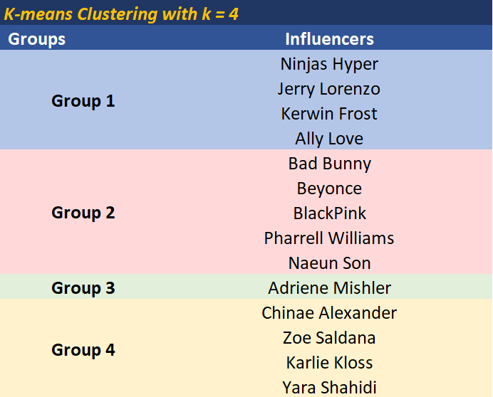
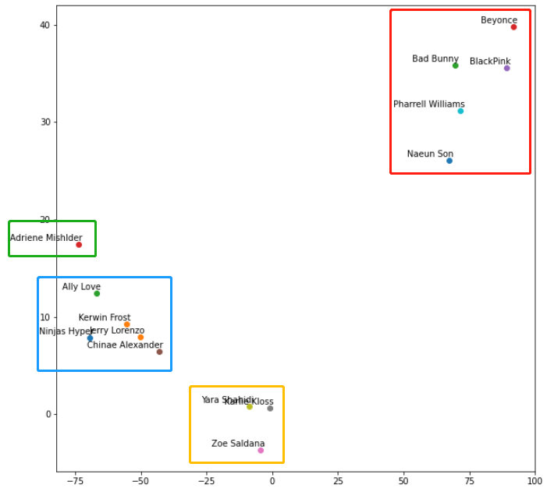
Influencers’ Fanbase Segments

Slide 35
CASE STUDY

Slide 36


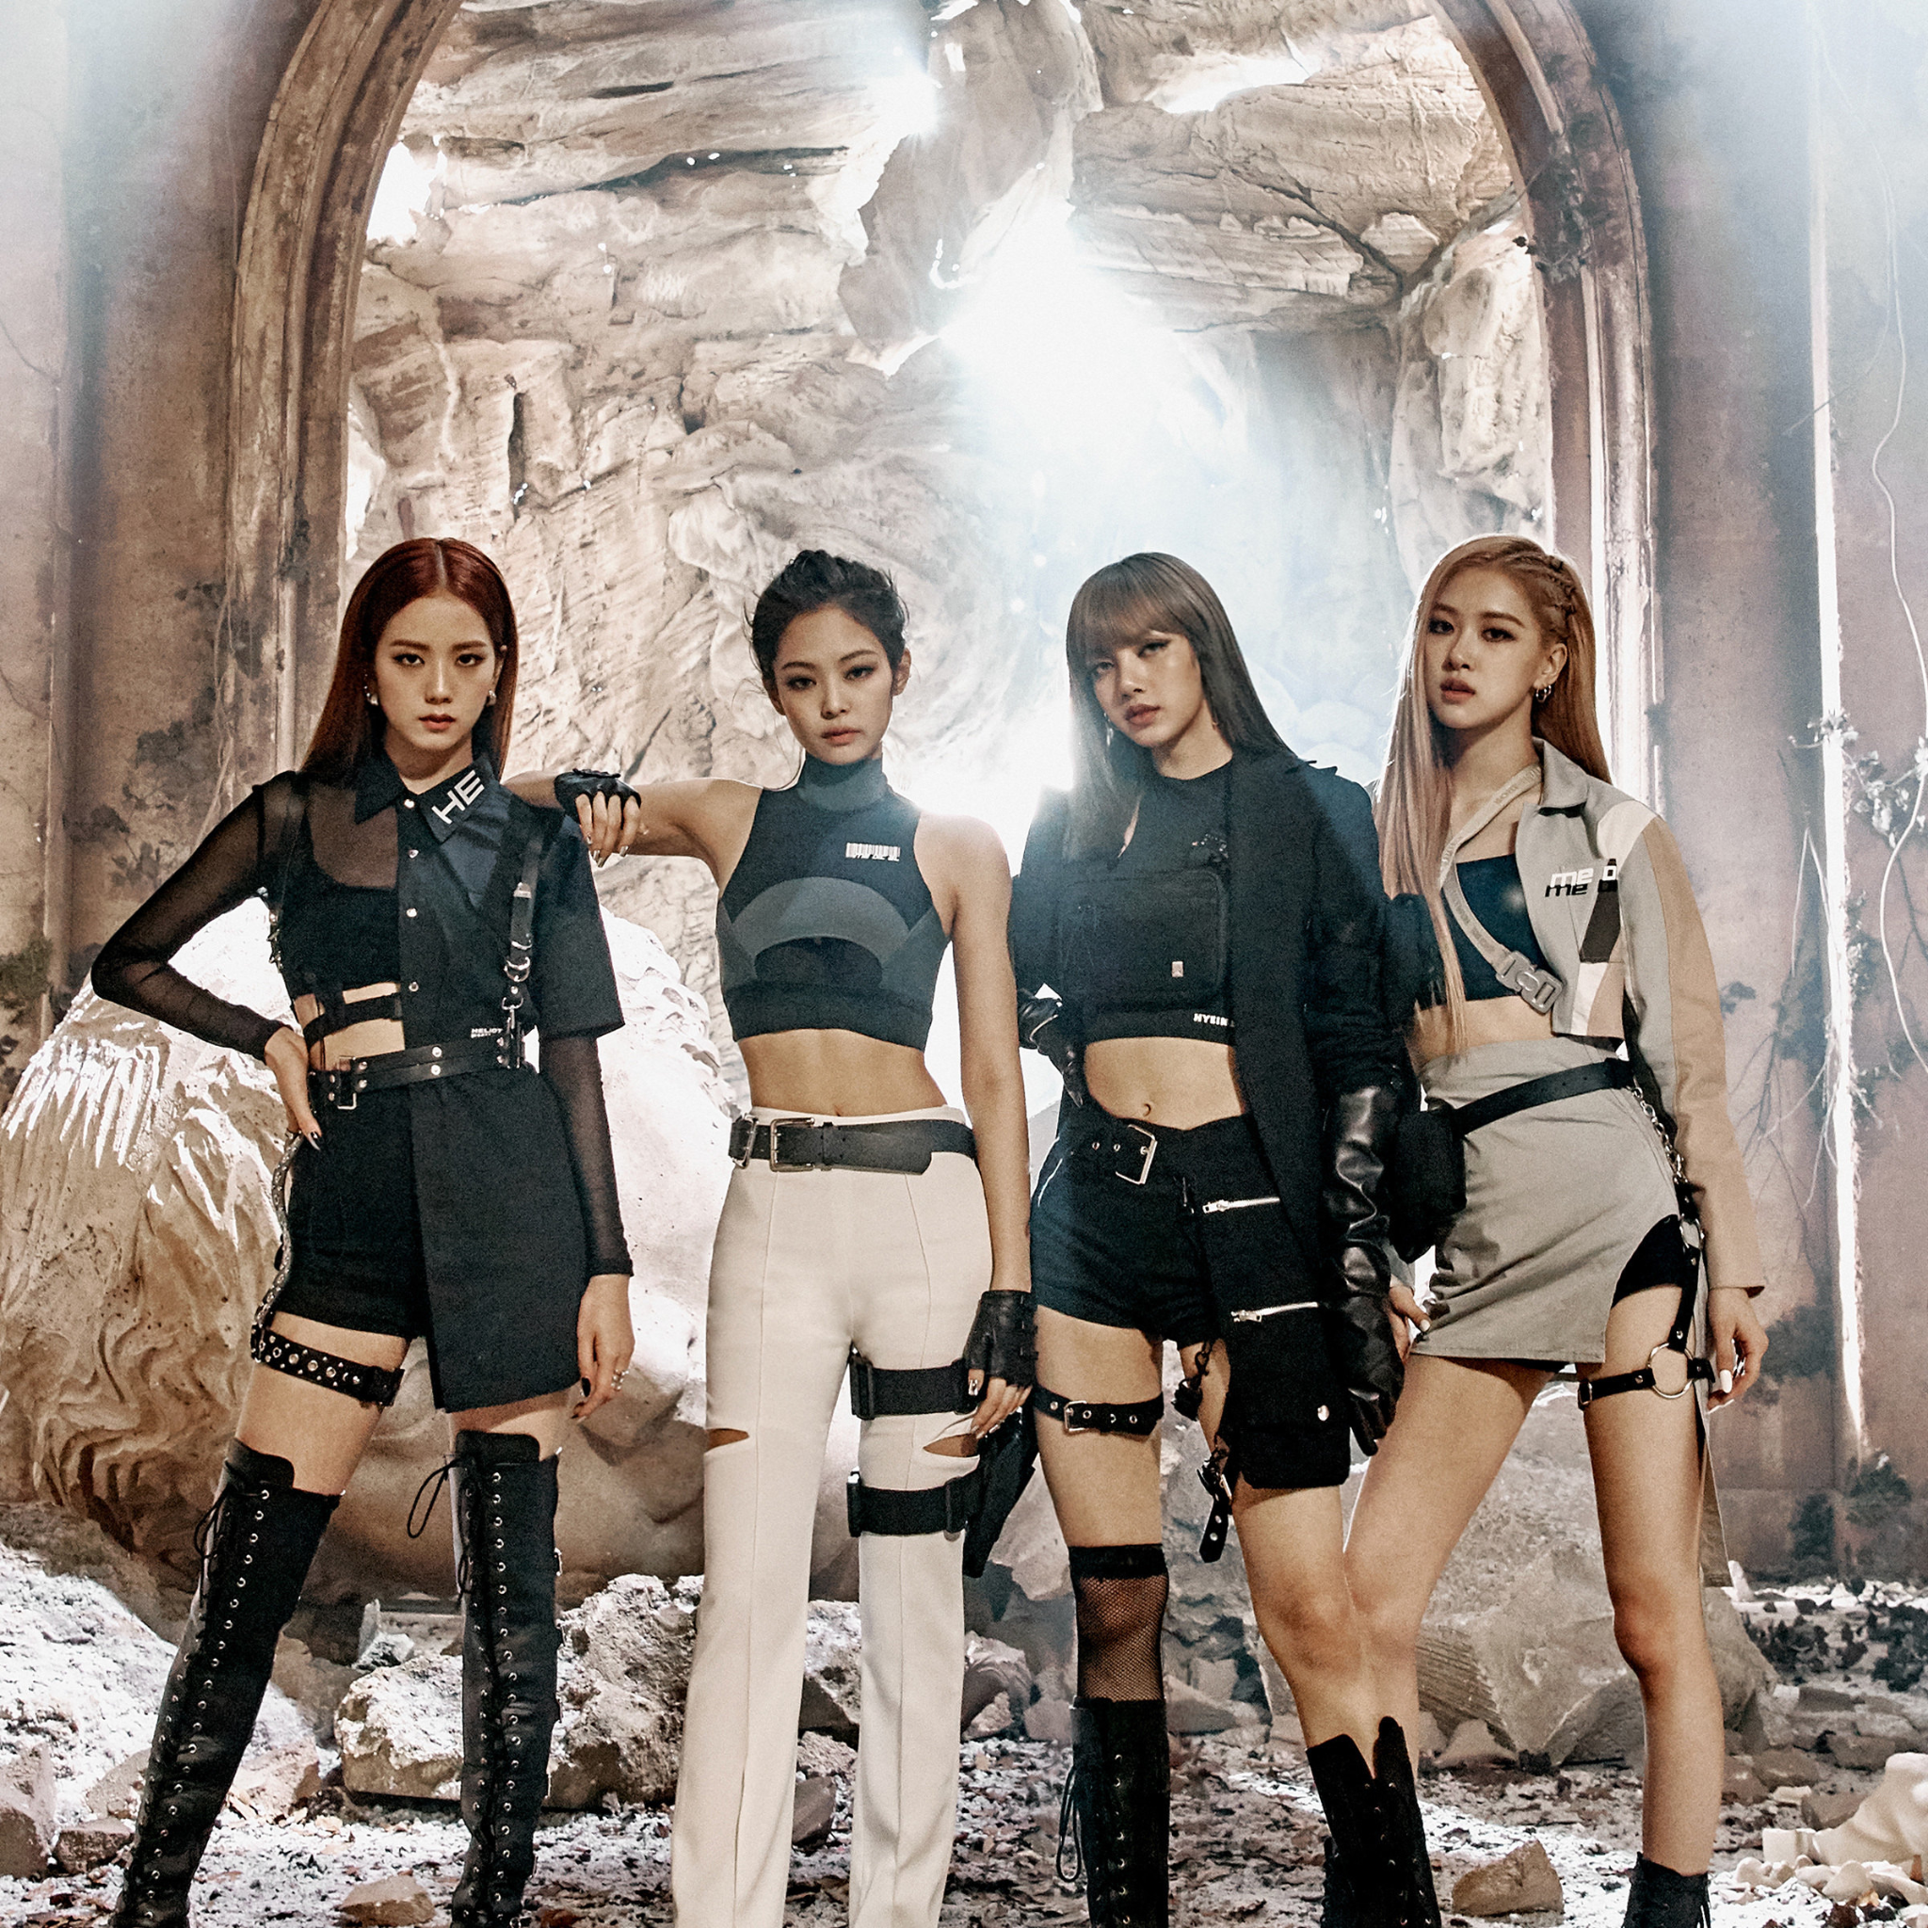
Due to a controversy, if we had to substitute Naeun Son and BlackPink with someone else, who would be the ideal candidate?
Business Question

Slide 37
Case study - Background
To better understand the international market, as well as to demonstrate the potential usage of the decision support system we built, we specifically picked 8 more korean groups/individuals (based on popularity, stage style, etc.) along with “Black Pink” and “Naeun Son” to conduct a case study.^{[11]}
Groups | Ranking | Reddit Subscribers
Black Pink | #2 | 122k
IZ*ONE | #5 | 27.4k
BTS (boy group) | #1 | 214k
NCT (boy group) | #6 | 29.4k
GFriend | #9 | 23.8k
Individuals | Groups | Ranking | Reddit Subscribers
Naeun Son | Apink | #14 | 7.5k
Seolhyun | AOA | (Nike) | 4k
Sana | TWICE | #2 | 102K
Solar | MAMAMOO | #7 | 18.5k
Miyeon | GI-DLE | #4 | 15k

Slide 38
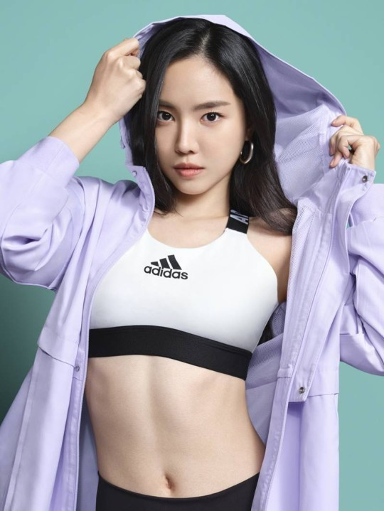
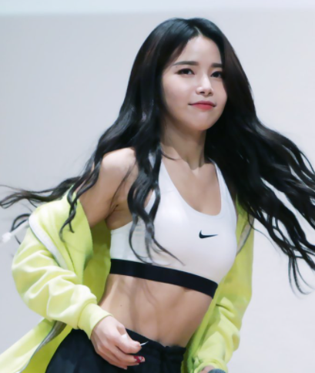

Case study - Hypothesis
Either Solar or Seolhyun could be the most similar individual to Naeun Son.
Naeun and Seolhyun look very similar to each other and Naeun and Solar are both prominent members of a girl group.
IZ*ONE could be the most similar girl group to BlackPink based on ranking (#5 & #2) and origin (Seoul, South Korea)
Sana and Miyeon could be very unique in this datasets since their stage positionings and artistic style are very different from the other groups or individuals.^{[11]}
≈
≈
Naeun
Solar
Seolhyun

Slide 39

Case study - Data
Data for Text Mining^{[5]}:
# of comments: 23381
# of words: 15M+
Data for SNA^{[5]}:
# of Influencers : 10
# of observations: 49274
# of users: 35147

Slide 40
Case study - Text Mining (word2vec+Tf-idf)
most_similar(“BlackPink”,
Pairwise_similarities,
'Cosine Similarity',
topn=2)
-------------------------------------------------
Name: BlackPink
Similar Influencers:
Celebrity: iZone : 0.7479952518415461
Celebrity: GFriend : 0.7131607796176859
most_similar(“Naeun Son”,
Pairwise_similarities,
'Cosine Similarity',
topn=2)
-------------------------------------------------
Name: Naeun Son
Similar Influencers:
Celebrity: Seolhyun : 0.6698078801647593
Celebrity: Solar : 0.6178915677265608
“Followers of BlackPink talk 74.79% similar to followers of IZ*ONE on reddit ”

Slide 41
Case study - Social Network Analysis (basic decision modeling)
To find the most
similar celebrity
model.best_sub("Naeun Son",n=2)
['Seolhyun', 'GFriend']
----------------------------------
model.best_complete("Naeun Son",n=2)
['Sana', 'Miyeon']
Model.best_sub ("BlackPink",n=2)
['GFriend', 'NCT']
----------------------------------
model.best_complete("BlackPink",n=2)
['Sana', 'Miyeon']
Average execution time: 1 min 16s
To find the most dissimilar celebrity

Slide 42
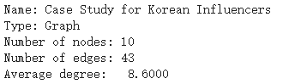
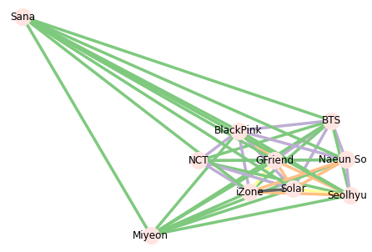
Case study - Social Network Analysis (node2vec)
Average execution time: 188 ms
------------------------------------
node2vec saved 97.52% of execution time

Slide 43
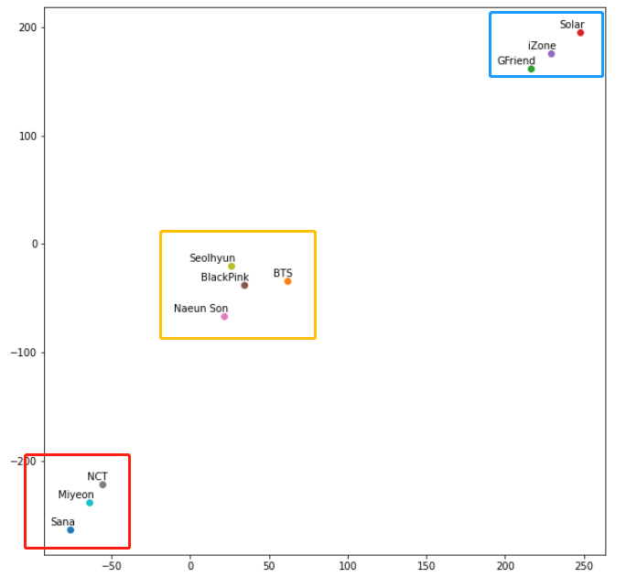
Case study - node2vec
T-SNE Plot
node2vec built-in feature
model.wv.most_similar("Naeun Son",topn=4)
(the groups were filtered out)
[('Seolhyun', 0.9898267984390259),
('Solar', 0.9860391616821289),
('Miyeon', 0.9639727878570557),
('Sana', 0.9561481475830078)]
--------------------------------------------
model.wv.most_similar("BlackPink",topn=4)
(the individuals were filtered out)
[('iZone', 0.996224582195282),
('GFriend', 0.9955752491950989),
('BTS', 0.9739093589782715),
('NCT', 0.9657029318809509),]

Slide 44
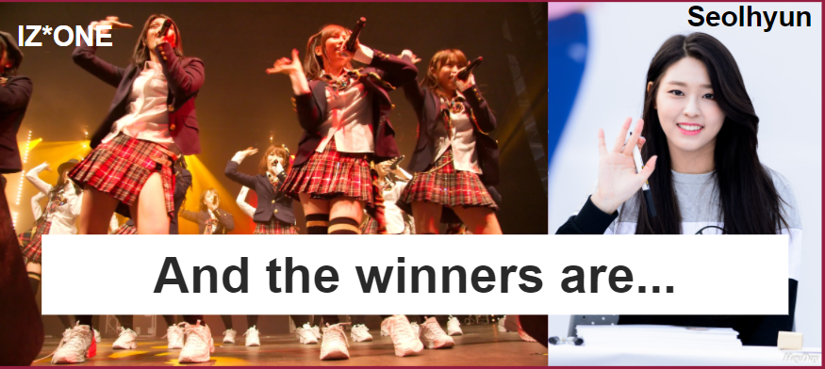
Conclusion
Techniques | Naeun Son | BlackPink
Text Mining - Word2vec+TFIDF | Seolhyun | IZ*ONE
Social Network Analysis - Basic decision modeling | Seolhyun | GFriend,NCT
Social Network Analysis - Node2vec | Seolhyun | IZ*ONE

Slide 45
LIMITATION & FUTURE WORK

Slide 46





Data
Different backgrounds.
Not all of them on Reddit .
22% of users aged from 18 to 29 (as of February 2019)^{[6]}
We observed that the functionality Reddit API is not constant when we try to extract large amounts of data at once.

Slide 47
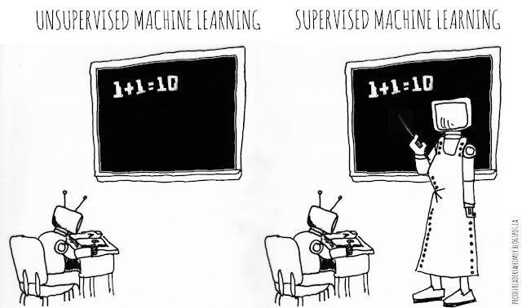
Text Mining
Limitations:
No ground truth that can help measure the performance of the models
Better performing models need labeled data
Potential Future Work:
Additional preprocessing of data & vetting of the processed data
Move on to supervised models

Slide 48
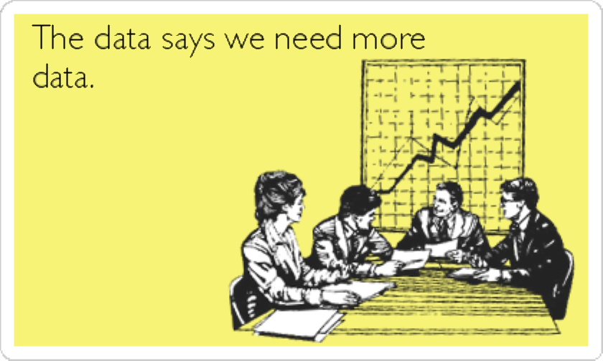
Limitations on the SNA
A small number of nodes will limit the performance (e.g. we only had 14 influencers in the dataset)
The data is unbalanced, so the model still could be biased.

Slide 49
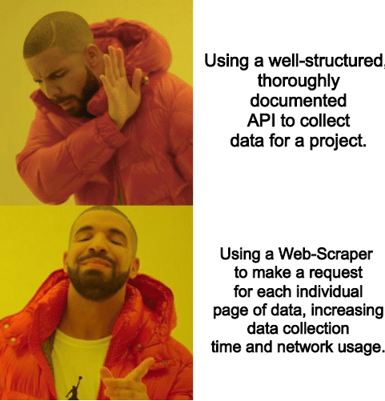
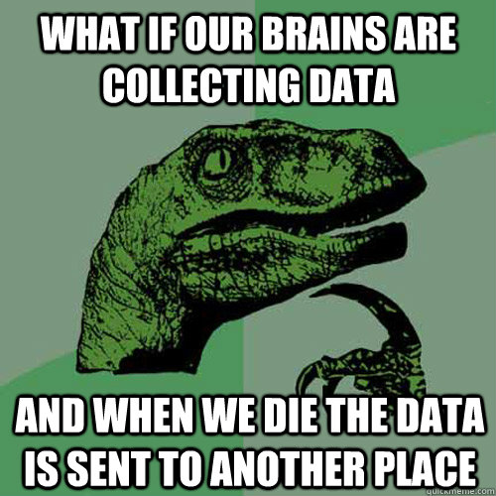
Potential Future Work of SNA
Expand the influencer list to conduct a larger scope of case studies
Collect data periodically (e.g. every 3 month) to study seasonal patterns and capture the fandom changes over time
Node2vec can be applied for online product recommendations

Slide 50
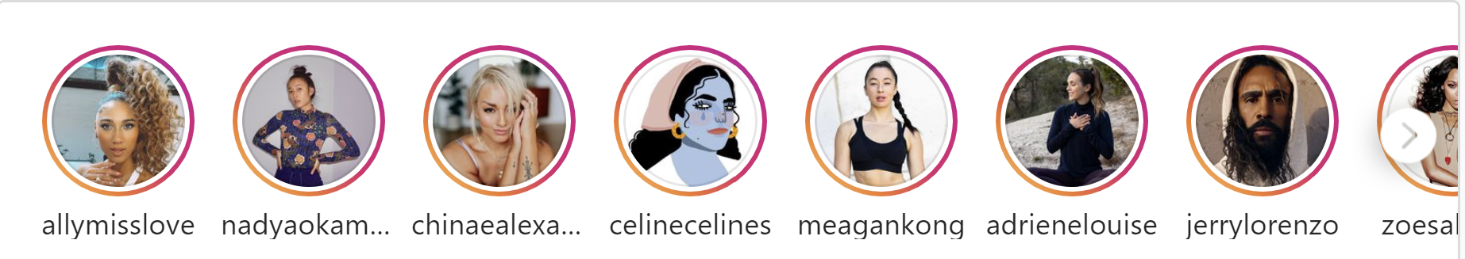
Possibilities on Analyzing Instagram Stories

Slide 51
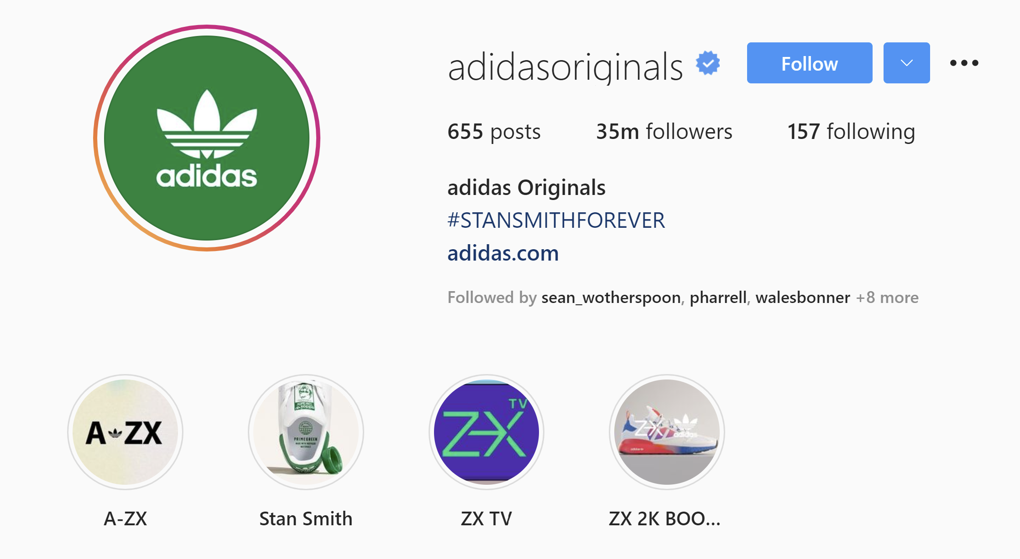
What are instagram Stories?
"Share all the moments of your day, not just the ones you want to keep on your profile"
Ephemeral: expires 24 hours after posting
Can be permanent if user add it as a highlight
Story
Highlights

Slide 52
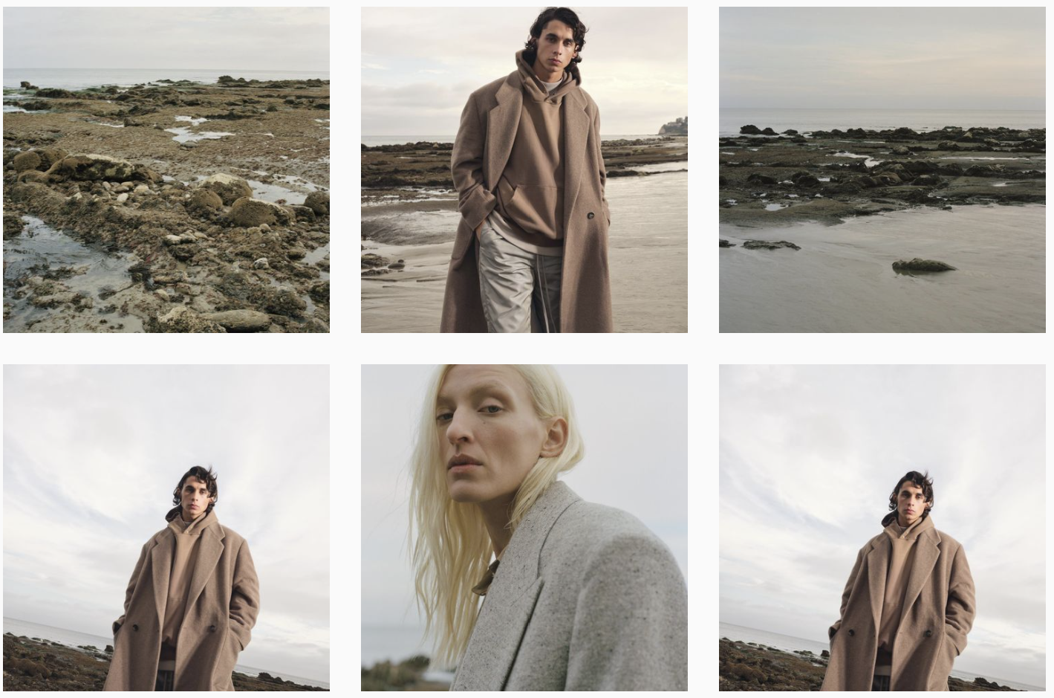
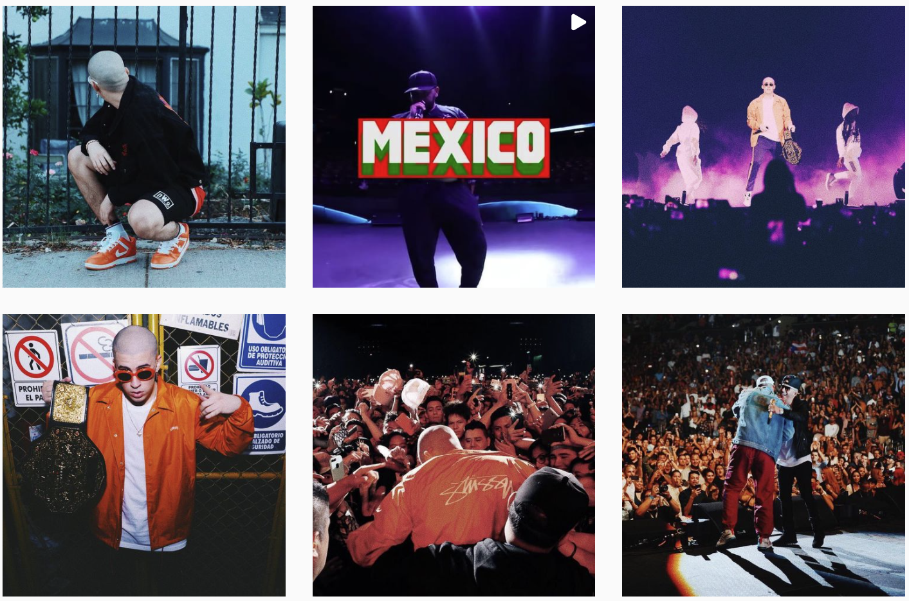
Business Value of Understanding Stories
Understand celebrities’ different aesthetics (visual feeling)
Avoid style overlap when marketing one product
Tailor product endorsement matchup with celebrities’ show style
Jerry Lorenzo
Bad Bunny

Slide 53
Problems to Solve
1
Computationally assessing image quality
Getting Instagram Stories
Detecting images with Adidas logos
How effectively they convey the visual idea?
2
Classifying images by style
How do they convey the visual idea uniquely?

Slide 54

Getting Instagram Stories
Open source API - Instaloader:
Python Module, Ready to use
Full capability of downloading media along with its metadata
Local output:
Media (jpg for image, mp4 and jpg thumbnail for videos)
Metadata (zipped json file)
https://instaloader.github.io/index.html
https://instaloader.github.io/as-module.html#module-instaloader

Slide 55
Limitations on Getting Instagram Stories
Need to create an instagram account and follow all target users
No way to catch expired stories
Need to run the script on 24-hour intervals to get all stories
429 Too Many Requests
Sometimes throw this error at around 200 fetches
Need multiple accounts to scrape the data

Slide 56
Google NIMA
A Neural Image Assessment model
Quantification of image quality and aesthetics
Technical Score: Looking good? Noise, blur, compression artifacts...
Aesthetic Score: Attractive? Beautifulness, human perception of good feeling.
Trained with histograms of human ratings for every image
Produces a distribution of ratings for any given image — on a scale of 1 to 10, assigning likelihoods to each of the possible scores
Calculates a mean score correlates closely with human perception.
https://ai.googleblog.com/2017/12/introducing-nima-neural-image-assessment.html
https://idealo.github.io/image-quality-assessment/

Slide 57
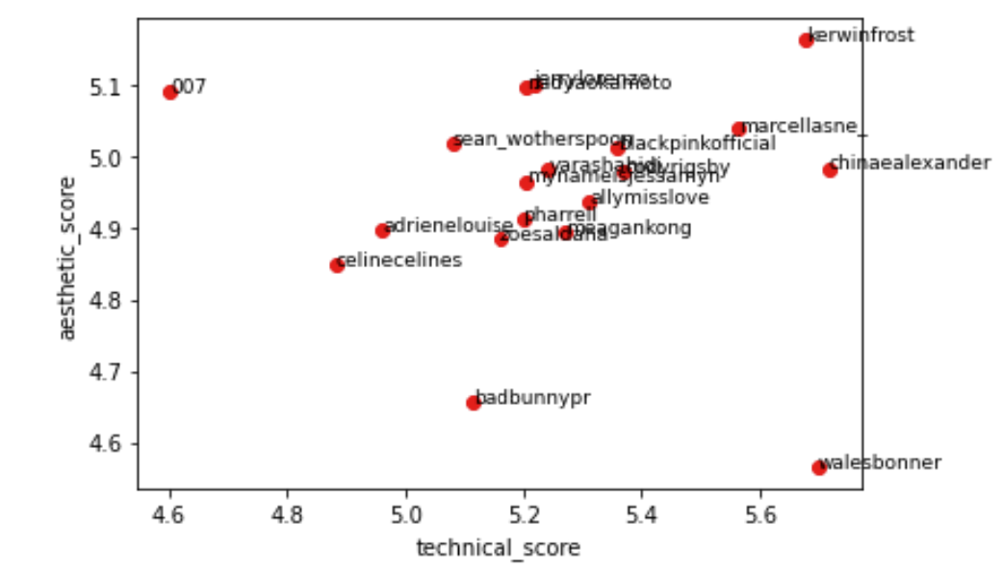
Assessing Instagram Stories Quality

Slide 58


Analyzing Images with Google NIMA
Technical: 5.3163
Aesthetic: 5.4846
Technical: 4.3772
Aesthetic: 4.3204
Blurry
Text on top
Color Fades out
Color composition not ideal
Wales Bonner
Karlie Kloss

Slide 59


Analyzing Images with Google NIMA
Technical: 4.2074
Aesthetic: 6.0637
Technical: 5.5548
Aesthetic: 4.0486
Adriene Mishler

Slide 60


Analyzing Images with Google NIMA
Technical: 4.5234
Aesthetic: 5.9242
Technical: 4.2735
Aesthetic: 3.2516
Bad Bunny

Slide 61


Analyzing Images with Google NIMA
Technical: 6.2090
Aesthetic: 5.6127
Technical: 4.6019
Aesthetic: 4.3183
Black Pink

Slide 62


Analyzing Images with Google NIMA
Technical: 4.9158
Aesthetic: 5.9319
Technical: 5.1978
Aesthetic: 3.6918
Chinae Alexander

Slide 63
Classifying Images by Style
Vislab by Sergey Karayev - a set of Python modules for visual recognition
Features: based on color dependency, composition, visual attention…
Architecture: Fine-tuned Caffe Deep convolutional Framework
Dataset: 80K flickr images with 20 style labels
Style labels based on Optical techniques, Atmosphere, Mood, Composition styles, Color and Genre.
Scalability:
Crossing-platform: train from flicker and test on pinterest, AVA
Add own training set with labels
https://sergeykarayev.com/files/1311.3715v3.pdf
https://github.com/sergeyk/vislab
http://vislab.berkeleyvision.org/

Slide 64










20 Style Labels
Macro
Bokeh
Depth-of-Field
Long Exposure
HDR
Hazy
Sunny
Serene
Melancholy
Ethereal

Slide 65










20 Style Labels
Minimal
Geometric
Detailed
Texture
Romantic
Pastel
Bright
Noir
Vintage
Horror

Slide 66

Classifying Stories by Style
We can get all images of same style.
Combine with query of celebrities to explore each one’s dominant visual style.
Helps making marketing strategies
Minimal overlap
Target specific groups

Slide 67
Limitations of Image Style Classification
Pre-trained model with fixed labels
For better customized performance, need to define own our style labels and manually label the training data, then retrain the classifier.

Slide 68
Thank you!

Slide 69
REFERENCE

Slide 70
Reference
Alammar, J. (2019, March 27). The Illustrated Word2vec. Jay Alammar's Blog. https://jalammar.github.io/illustrated-word2vec/.
Cohen, E. (2018, April 23). node2vec: Embeddings for Graph Data. Medium. https://towardsdatascience.com/node2vec-embeddings-for-graph-data-32a866340fef.
Graf, A., &amp; Koch-Kramer, A. (n.d.). Instaloader. https://instaloader.github.io/.
Grover, A., & Leskovec, J. (2016, July 3). node2vec: Scalable Feature Learning for Networks. arXiv.org. https://arxiv.org/abs/1607.00653.
Jiang, J. (2021, March 23). Use R to Calculate Boilerplate for Accounting Analysis. Medium. https://towardsdatascience.com/use-r-to-calculate-boilerplate-for-accounting-analysis-f4a5b64e9b0d.
Jiang, J. (n.d.). ASU_Adidas_Applied_Project_2021. GitHub. https://github.com/jinhangjiang/ASU_Adidas_CapstoneProject.
Karayev, S.(n.d.) vislab. Github. https://github.com/sergeyk/vislab
Karayev, S., Hertzmann, A., Trentacoste, M., Han, H., Winnemoeller, H., Agarwala, A., &amp; Darrell, T. (2014). Recognizing Image Style. Proceedings of the British Machine Vision Conference 2014. https://doi.org/10.5244/c.28.122
Lennan, C. (2018, July 9). Using Deep Learning to automatically rank millions of hotel images. Medium. https://medium.com/idealo-tech-blog/using-deep-learning-to-automatically-rank-millions-of-hotel-images-c7e2d2e5cae2
Lennan, C., Tran, D., et al. (n.d.) image-quality-assessment. Github. https://github.com/idealo/image-quality-assessment/
Reddit Usage and Growth Statistics: How Many People Use Reddit in 2021? Backlinko. (2021, February 25). https://backlinko.com/reddit-users.
Reimers, N., & Gurevych, I. (2019, August 27). Sentence-BERT: Sentence Embeddings using Siamese BERT-Networks. arXiv.org. https://arxiv.org/abs/1908.10084/.
sdaylorsdaylor. (2019, March 1). What does embedding mean in machine learning? Data Science Stack Exchange. https://datascience.stackexchange.com/questions/53995/what-does-embedding-mean-in-machine-learning.
Sieg, A. (2019, November 13). Text Similarities : Estimate the degree of similarity between two texts. https://medium.com/@adriensieg/text-similarities-da019229c894.
Talebi, H., &amp; Milanfar, P. (2018, April 26). NIMA: Neural Image Assessment. IEEE Transactions on Image Processing, 27(8), 3998–4011. https://doi.org/10.1109/tip.2018.2831899
TensorFlow Team, G. (2017, November 20). Introducing TensorFlow Feature Columns. Google Developers Blog. https://developers.googleblog.com/2017/11/introducing-tensorflow-feature-columns.html.
[UPDATE] January 2021 Top 50 KPOP Popularity Ranking. KPOP OFFICIAL. (2021, February 1). https://kpopofficial.com/top-50-kpop-popularity-reputation-ranking-january-2021/#3_Kpop_Idol_Group_Popularity_Brand_Reputation_Ranking_All_Kpop_Groups.
What Is Text Analytics? MonkeyLearn Blog. (2019, November 20). https://monkeylearn.com/blog/what-is-text-analytics/.
Notes:
APA

Slide 71
APPENDIX

Slide 72


Word2vec - Skipgram
Source: https://jalammar.github.io/illustrated-word2vec/

Slide 73

Word2vec
It did twice dimension reduction during the process:
a corpus of words → a list of unique words with vector representations
vectors → 2D embeddings

Slide 74




Word2vec - Evaluation Metrics

Slide 75


How the TF-IDF Calculated

Slide 76
How the model works
Treat 14 celebrities as 14 documents
m = 14
Top 30% of unique words based on frequency across all the documents^{[9]}
the number of unique words = 100,000
n = 100,000*0.3 = 30,000
Based on a paper released by Google, the vector size of word2vec embeddings can be determined by the following formula:^{[10]}
v = 10M**0.25 ≈ 57
4. The shape of the final embeddings is: (14,30000,57)

Slide 77

How the model works

Slide 78


SBERT Implementation
One of the best available models for Semantic Textual Similarity (STS) is:
stsb-bert-large - STSb performance

Slide 79

SNA Implementation
model.crosstable()
Celebrity Celebrity
Ally Love Adriene Mishlder 3.0
Bad Bunny Adriene Mishlder 0.0
Ally Love 41.0
Beyonce Adriene Mishlder 0.0
Ally Love 26.0
...
Zoe Saldana Kerwin Frost 6.0
Naeun Son 9.0
Ninjas Hyper 23.0
Pharrell Williams 24.0
Yara Shahidi 82.0
Length: 91, dtype: float64

Slide 80
SNA with node2vec
Analyzing
Data
Social Network Analysis
(SNA)
w. node2vec
Use Embeddings
Draw Graph
EB
NX
Generate Embeddings

Slide 81

SNA with node2vec
Usage 2: T-SNE Plot
Usage 1: node2vec built-in feature
model.wv.most_similar("Celebrity 12",topn=5)
[('Celebrity 1', 0.9880407452583313),
('Celebrity 8', 0.9570997071266174),
('Celebrity 4', 0.9056358766555786),
('Celebrity 6', 0.8254547381401062),
('Celebrity 5', 0.7046592545509338)]
Usage 3: K-means Clustering
Group 1
0 ... n
Celebrity 1 -0.019673 ... 0.085747
Celebrity 3 -0.011764 ... 0.091183
[2 rows x n columns]
....
Group k
0 ... n
Celebrity 4 0.022665 ... 0.011859
Celebrity 5 0.018963 ... 0.010145
[2 rows x n columns]

Slide 82

SNA Implementation
Average execution time: 150 ms
------------------------------------
node2vec saved 99.98% of execution time
Usage 1: node2vec built-in feature
model.wv.most_similar("Naeun Son",topn=2)
[('BlackPink', 0.9982033967971802),
('Beyonce', 0.988198926448822)]
e.g. One of the outputs of training process

Slide 83
Potential Future Work of Text Mining
Remove boilerplate to increase the informativeness and uniqueness of the “documents” for each celebrity.^{[4]}
*In textual analysis, Boilerplate is a combination of words that can be removed from a sentence without significantly changing the original meaning
[(('bot', 'action', 'performed', 'automatically'), 4186),
(('action', 'performed', 'automatically', 'please'), 3454),
(('performed', 'automatically', 'please', 'contact'), 3454),
(('automatically', 'please', 'contact', 'moderator'), 3454)]
Notes:
additional preprocessing of data & vetting of processed data
Move on to supervised models

Slide 84
Case study - node2vec
K-means Clustering
Group 1
0 1 2 ... 13 14 15
Sana -0.089618 -0.071649 -0.003039 ... -0.043400 -0.102120 0.014032
NCT -0.109779 -0.097330 0.032881 ... -0.048294 -0.241587 0.031689
Miyeon -0.144210 -0.067727 0.037089 ... -0.058805 -0.197231 -0.010469
[3 rows x 16 columns]
--------------------------------------------------------------
Group 2
0 1 2 ... 13 14 15
BTS -0.186073 -0.159345 0.043289 ... -0.118391 -0.346044 0.027395
BlackPink -0.186074 -0.117281 0.071182 ... -0.112053 -0.334396 -0.008005
Naeun Son -0.139308 -0.119381 0.069812 ... -0.106206 -0.317578 -0.010998
Seolhyun -0.220078 -0.148290 0.036138 ... -0.085400 -0.346950 0.023048
[4 rows x 16 columns]
--------------------------------------------------------------
Group 3
0 1 2 ... 13 14 15
GFriend -0.234220 -0.147478 0.064113 ... -0.101717 -0.409747 -0.007356
Solar -0.260542 -0.194174 0.086498 ... -0.134705 -0.450908 0.024723
iZone -0.236252 -0.178684 0.092774 ... -0.120792 -0.407976 0.011584
[3 rows x 16 columns]
--------------------------------------------------------------
Notes:
*

